Slide 1
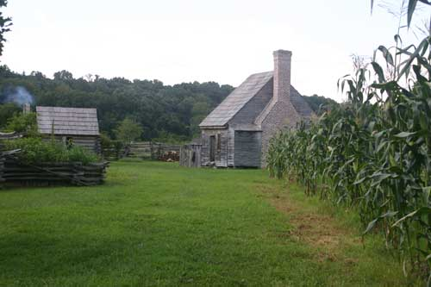
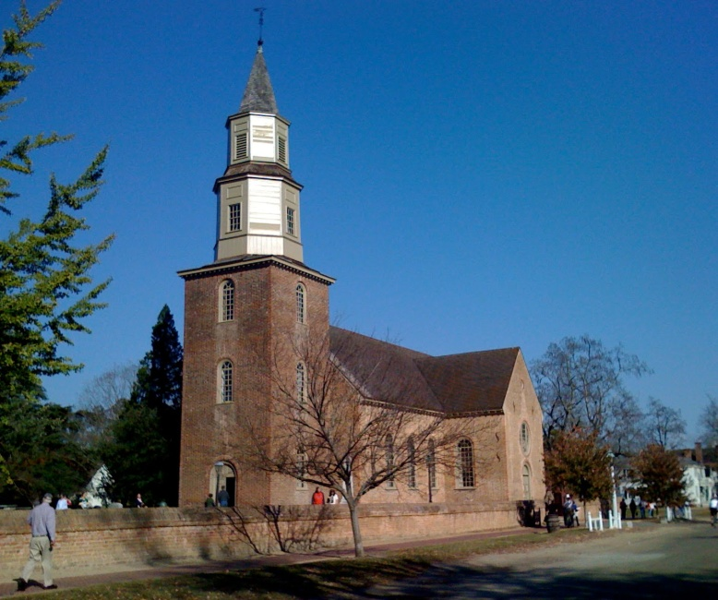
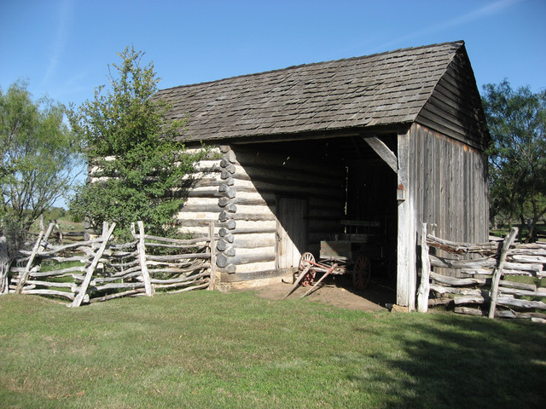
Cultural Landscapes
By Miss O.
VS 4b

Slide 2

What is a culture?

Slide 3
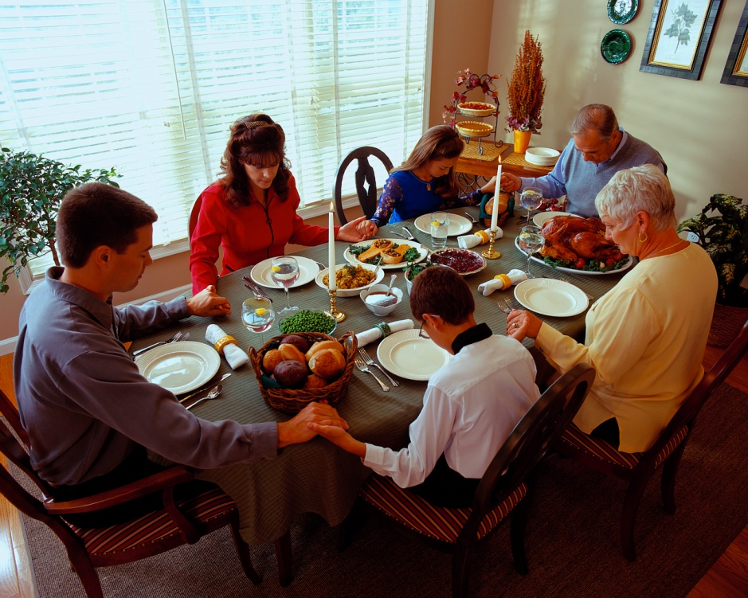
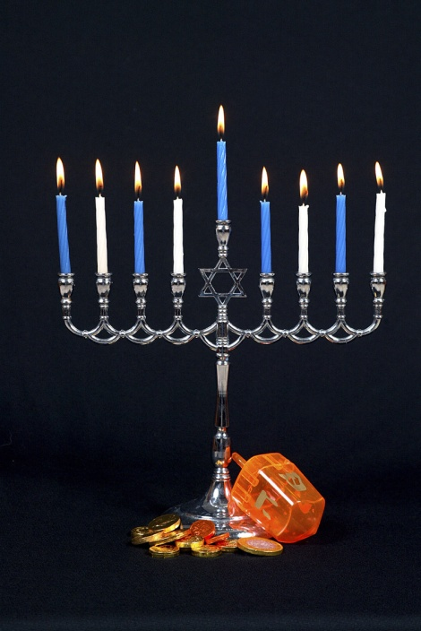
Culture of Colonial Virginia
Whenever people settle an area, they change the culture and landscape to reflect their beliefs, customs, and architecture.

Slide 4
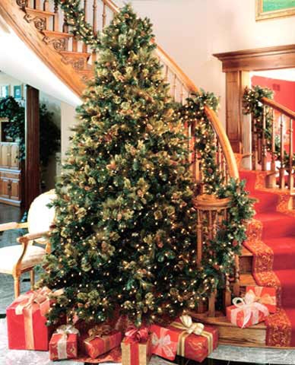
What are beliefs?
What someone feels is true.
What are customs?
People’s traditions.

Slide 5
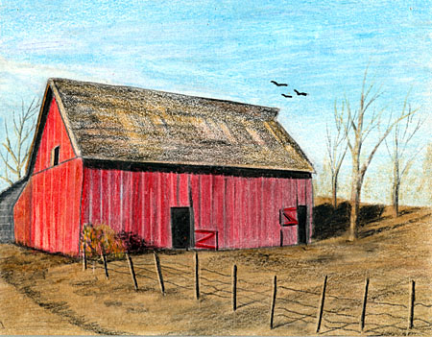
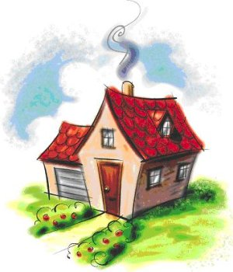
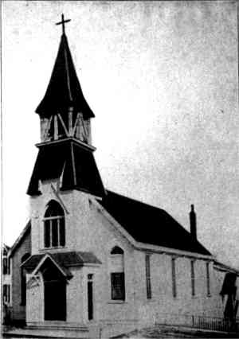
Architecture
The way buildings are designed.
Examples of architecture that reflect different cultures include:
  Barns
  Homes
  Places of worship (e.g. churches)

Slide 6
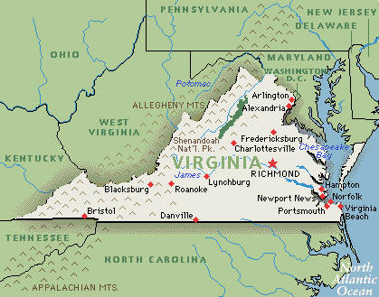
Place names reflecting culture:
English → Richmond
American Indian → Roanoke

Slide 7
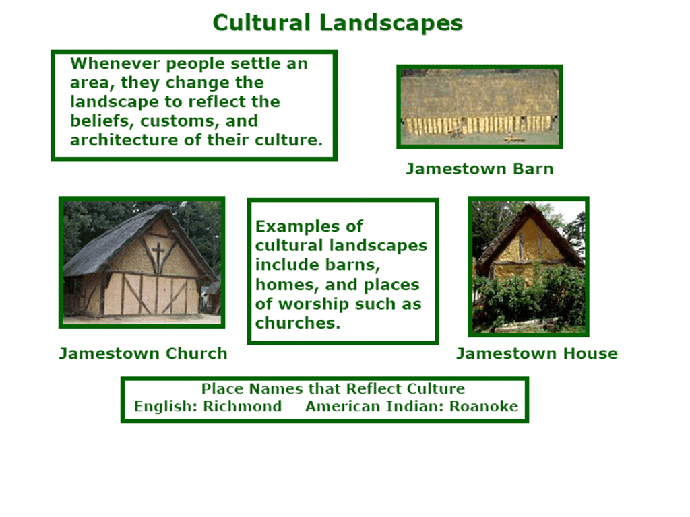

Slide 8
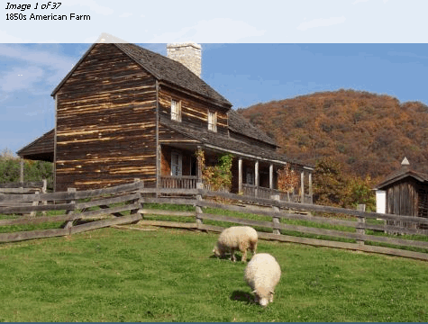

Slide 9
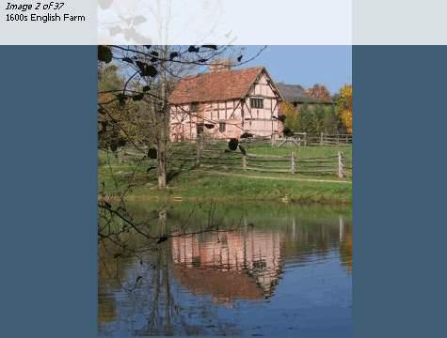

Slide 10
Similarities and Differences?

Slide 11
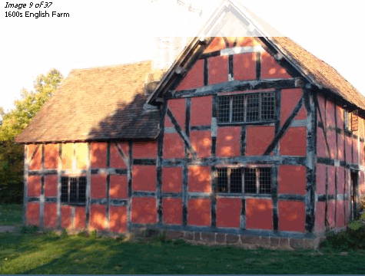

Slide 12
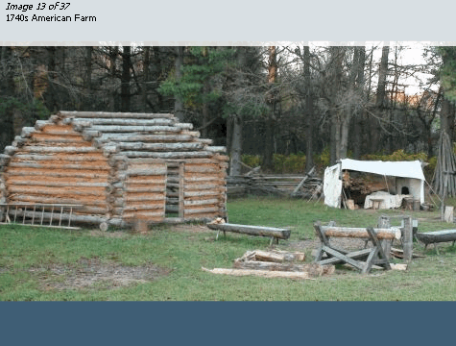

Slide 13
Similarities and Differences?

Slide 14
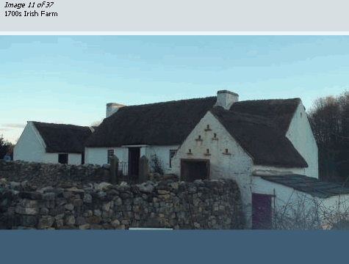

Slide 15
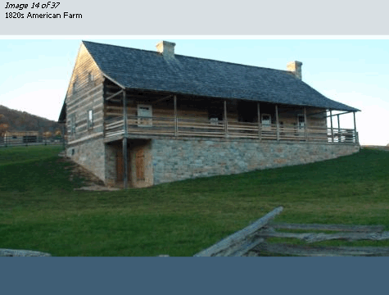

Slide 16
Similarities and Differences?

Slide 17
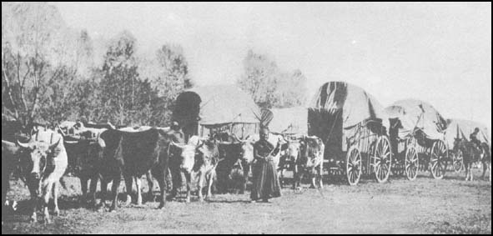
Immigrants: migrated (traveled from an old place to a new place for a better life)

Slide 18
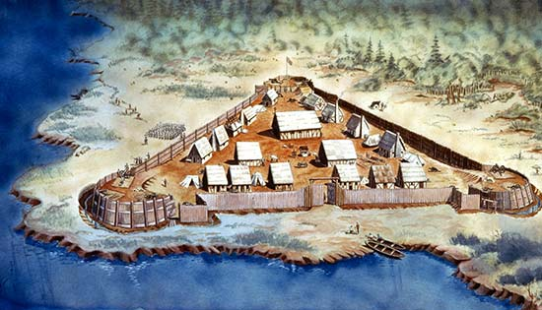
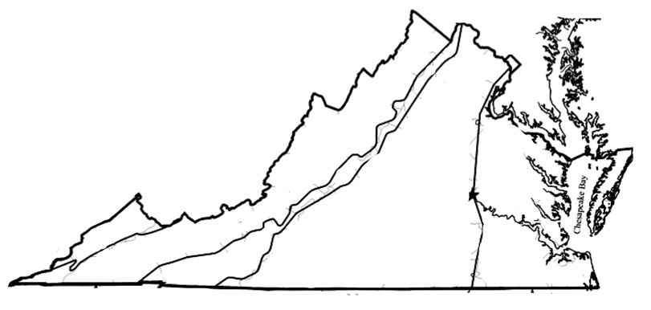
English
And other Europeans settled primarily in the Coastal Plain (Tidewater) and Piedmont regions.
They came for economic venture (power and money)→ Jamestown.

Slide 19
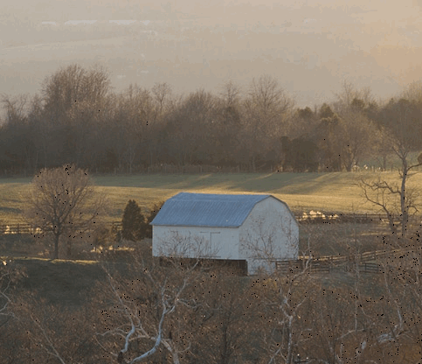
Germans and Scots-Irish
Settled primarily in the Shenandoah Valley, which was along the migration route.
They came to farm.

Slide 20
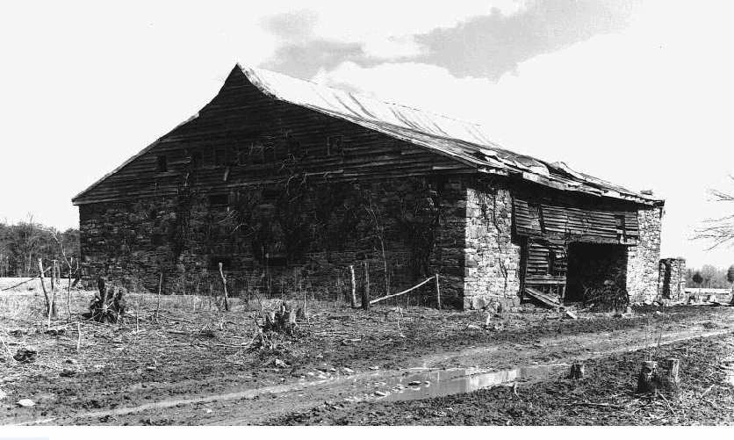
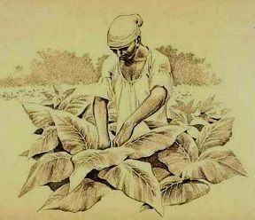
Africans
Were settled primarily in the Coastal Plain (Tidewater) and Piedmont regions, where tobacco agriculture required a great deal of labor.
Tobacco barn →

Slide 21
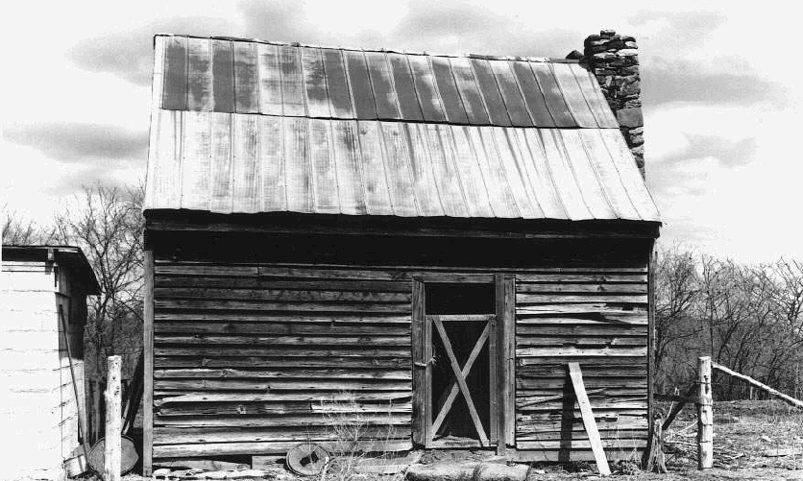
Africans
Africans came against their will to grow tobacco on other peoples’ plantations.
Slave Quarters →

Slide 22
American Indians
Prior (before) to the arrival of the settlers, American Indians lived throughout Virginia.
After the settlers arrived, most were forced inland.

Slide 23
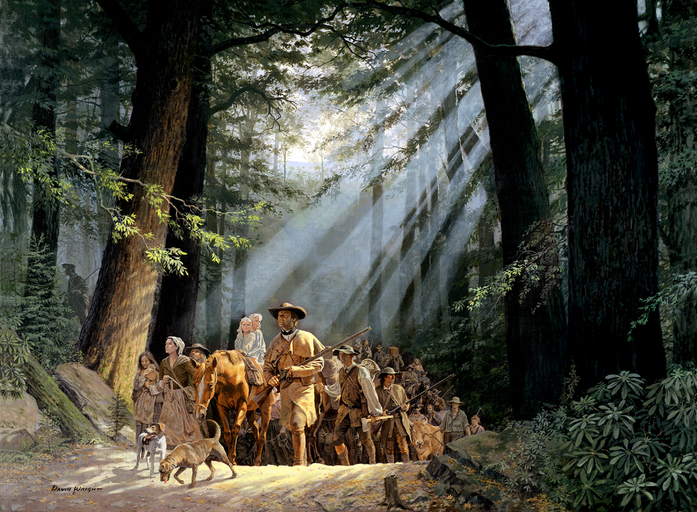
Migration
And living in new areas caused people to adapt old customs to their new environment.

