Slide 1
Fractions
Vocabulary Review

Slide 2
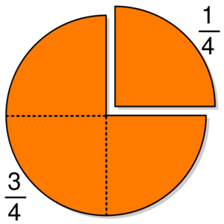
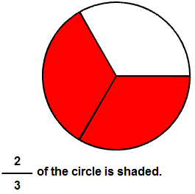
Fraction
Fraction – a symbol used to show parts of a whole.

Slide 3
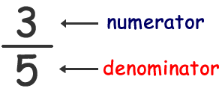
Fractions
Numerator – the top number in a fraction.
Denominator – the bottom number in a fraction. It tells how many parts there are all together.
Fraction bar – means to divide the bottom (denominator) into the top (numerator).

Slide 4
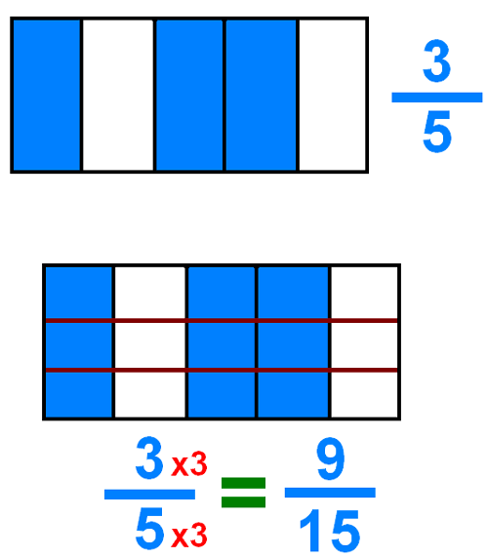
Equivalent Fractions
Equivalent fractions are fractions that show the same amount.
You can create equivalent fractions by either multiplying or dividing.

Slide 5
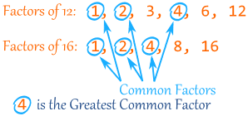
Simplest Form
Simplest form – A fraction in which the numerator and denominator have no common factors other than 1.
Common factors – a factor that two or more numbers have in common.
Factor – the numbers multiplied together to find a product.

Slide 6
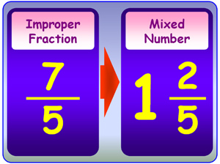
Improper Fractions
Improper Fractions – fractions in which the numerator (top) is the same or larger than the denominator (bottom).
These improper fractions are changed into mixed numbers by dividing the bottom into the top!

Slide 7
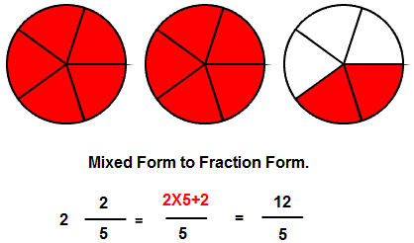
Mixed Numbers
Mixed Numbers – A whole number MIXED with a fraction.

